Slide 1
Advance Payroll Management System
Salary & Stock
Management System

Slide 2
Fix Allowance
Basic Salary 40000 +
Convince Allowance 25%
Medical Allowance 15%
House rent Allowance 10%
Basic Salary 30000+
Convince Allowance 20%
Medical Allowance 12%
House rent Allowance 10%

Slide 3
Fix Allowance
Basic Salary Less Then 30
Convince Allowance 2000%
Medical Allowance 1500%
House rent Allowance 1000%

Slide 4
Income Tax
Gross Pay 60000+
3 %
Gross Pay 50000+
2 %
Gross Pay Less Then 50000
0

Slide 5
Attendance Deduction
3 Late Means 1 Off
If You Are In Office After Half Day Company Will Pay You half Days Salary but If You Came In Office And You Are Going Before half Day So It’s Like A Off
Company Will Pay Over Time But Your Over Time Will Be Started After 1 hour

Slide 6
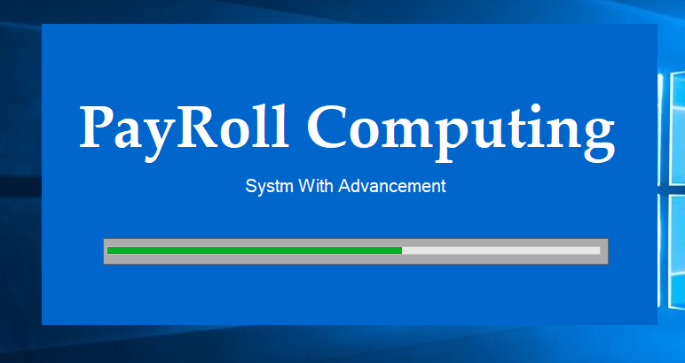
Splash Screen Design

Slide 7
Log Penal Description
We Have 4 Portal’s In Payroll Log In Form
Admin
Receptionist
Accountant
General Employee
So You Have To Select Account Type
Validations………….;

Slide 8
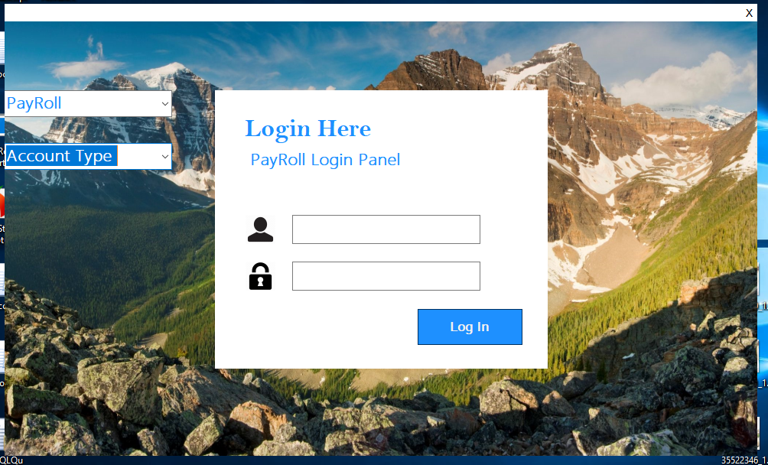
Log in Design

Slide 9
1st You Will Log in With developer Account its Fix In Application
After That Developer Will Make Company Account On Admin portal

Slide 10
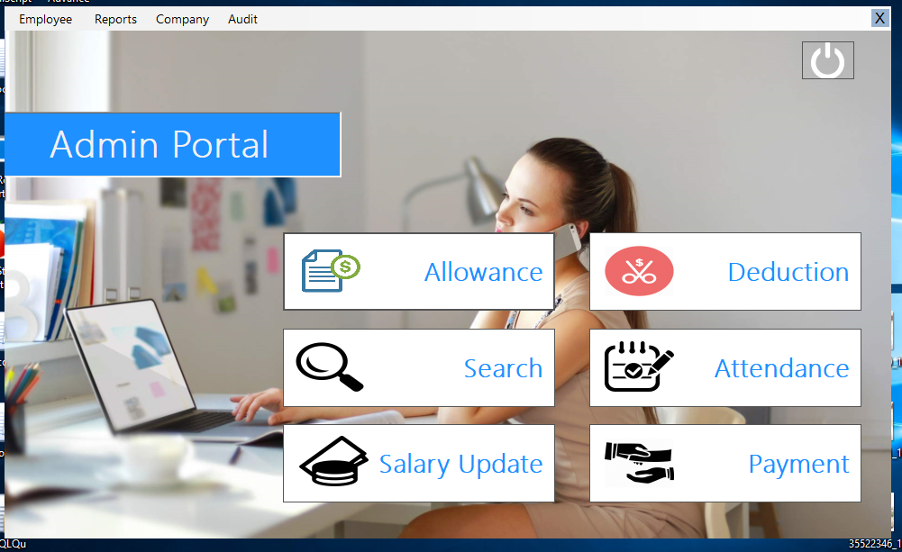
Admin Portal Desighn

Slide 11
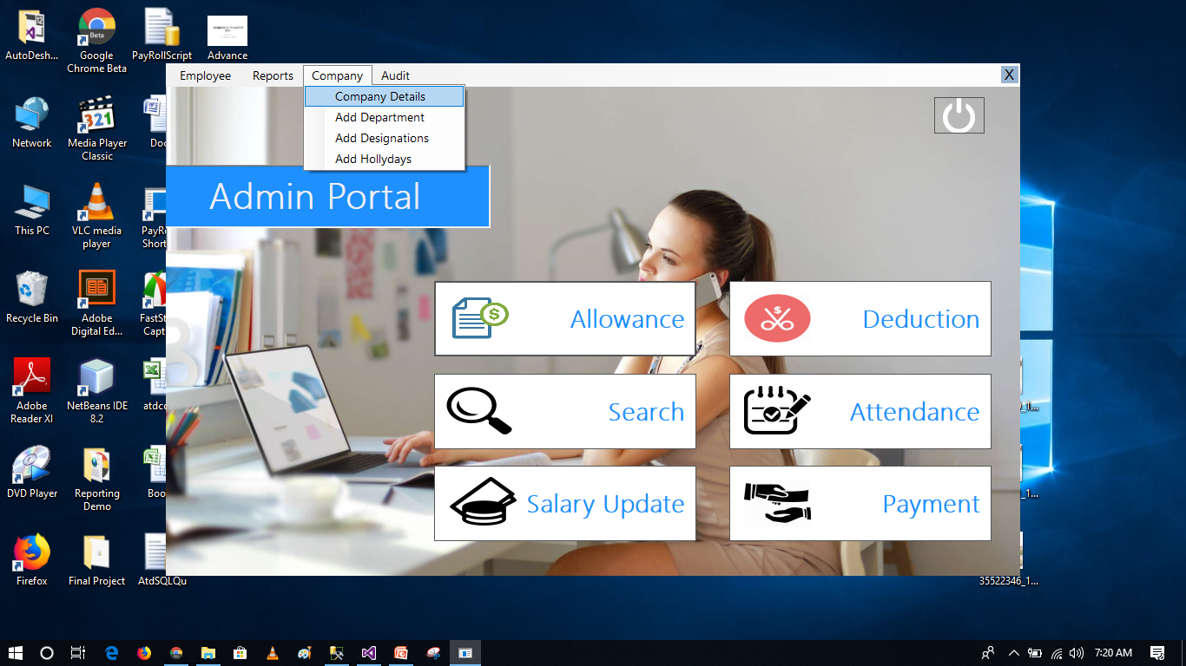
Company / Company Details

Slide 12
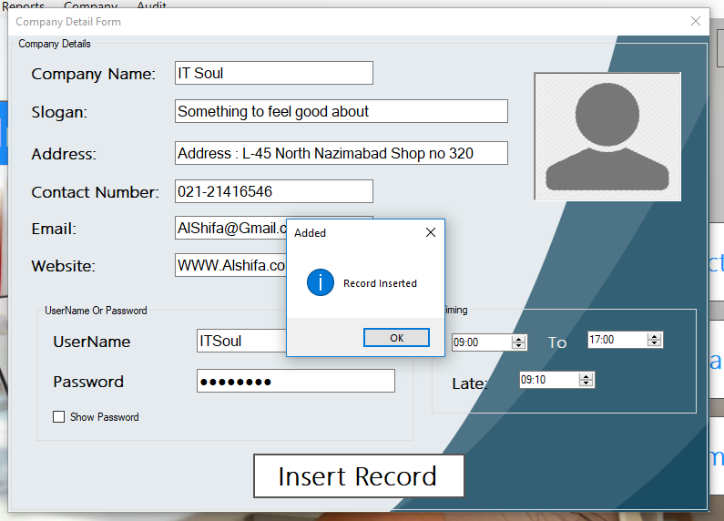
Company Detail Form 1st Look

Slide 13
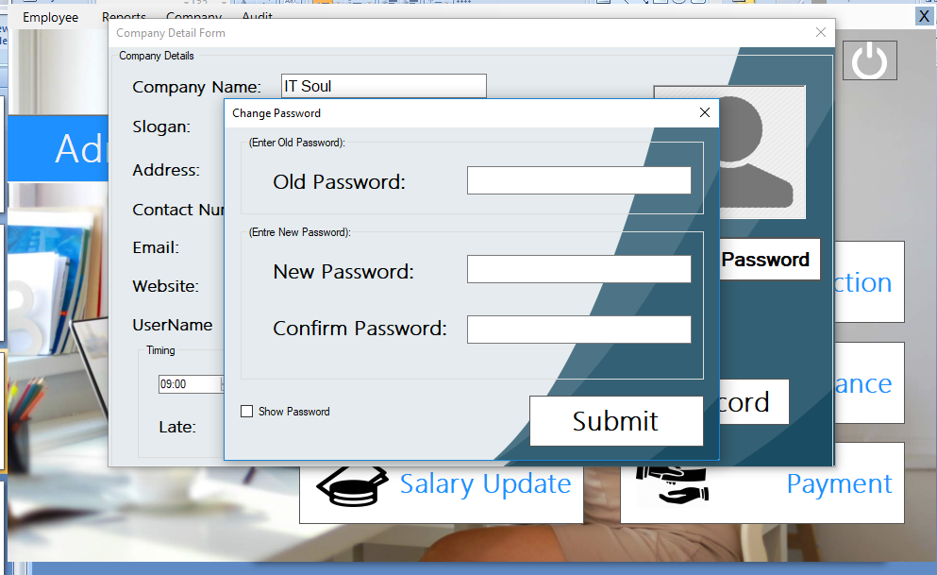
Pass Change

Slide 14
Department & Designation
After That You Will Add Department And Departments Designation
And After That You Will Registered Employees In that Departments
Validation………..

Slide 15
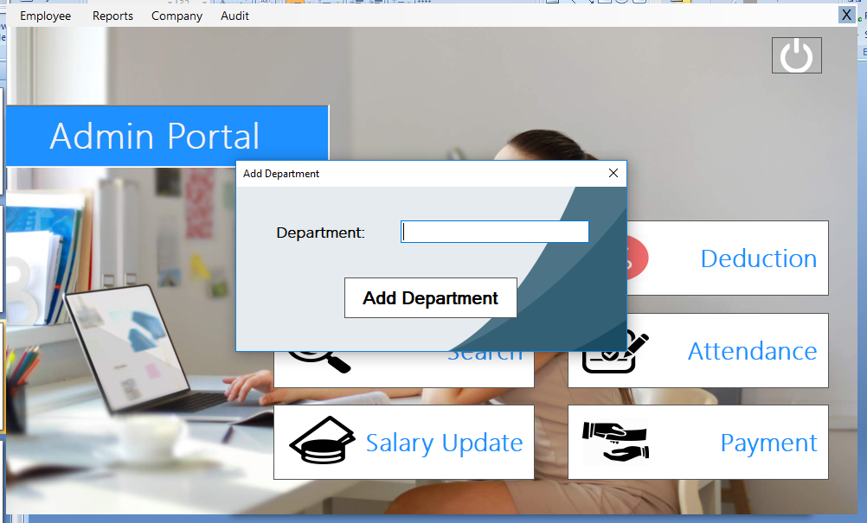
Add Department

Slide 16
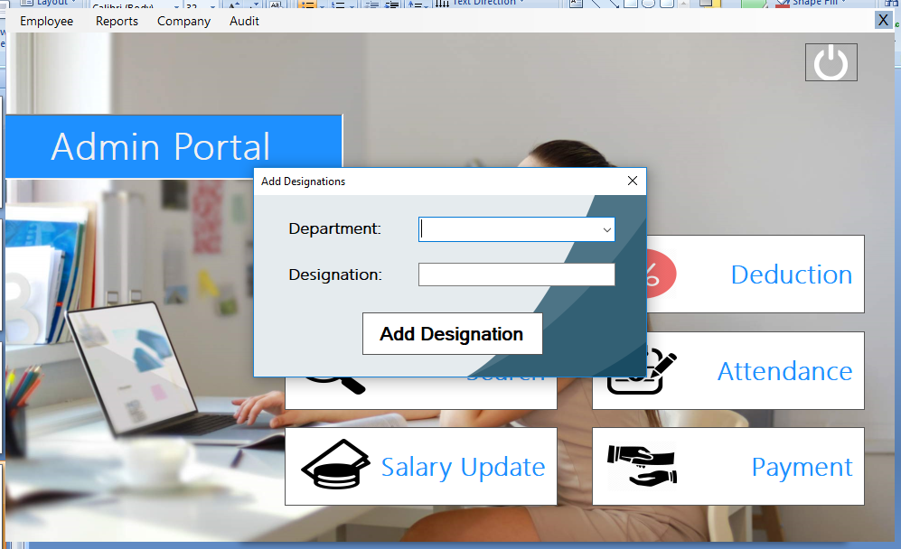
Add Designations

Slide 17
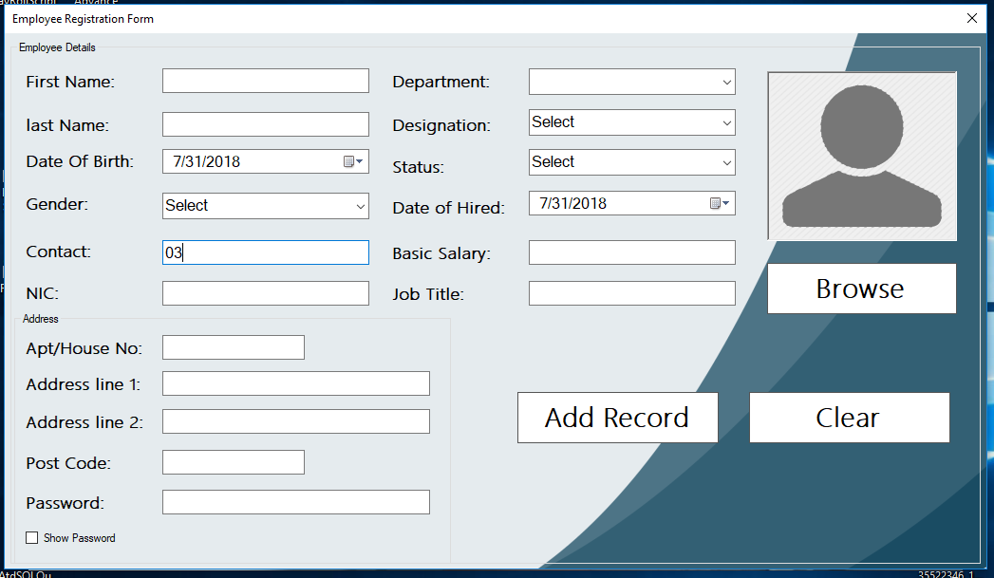
Employee Registration Form Validation……

Slide 18
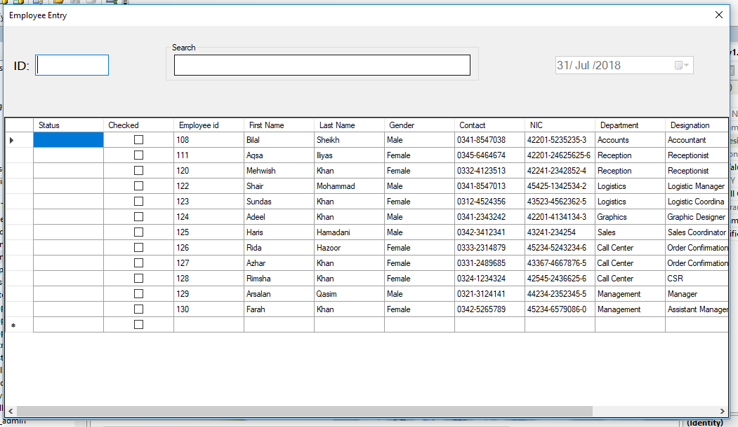
Attendance

